Slide 1
CSS - box model
Viktoras Lava www.viktoraslava.lt

Slide 2
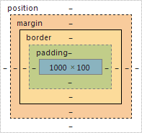
What is box model?
HTML elements can be considered as boxes. This box is called a box model and it consists of:
margins
borders
paddings
content
The term “box model” is used when we talk about the page layout.

Slide 3
Types of CSS boxes
section { display: block; }
li {display: inline-block; }
span { display: inline; }
There are 3 common types of CSS boxes:
block
inline-block
inline
Most of the elements already have a display: block rule set up. You can check that in your inspector.
Example

Slide 4



Types of CSS boxes
display: block
display: inline-block
display: inline

Slide 5
Types of CSS boxes
display: block
width & height
padding & margin
border
vertical-align
Example
display: inline-block
width & height
padding & margin
border
vertical-align
display: inline
width & height
padding & margin
border
vertical-align

Slide 6
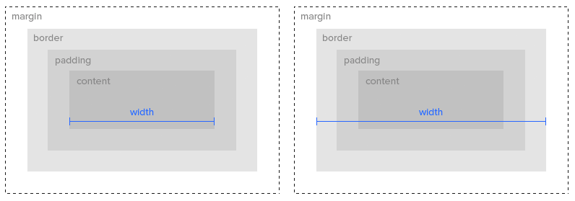
Box model settings
There are 2 settings for the box model: content-box and border-box.

Slide 7
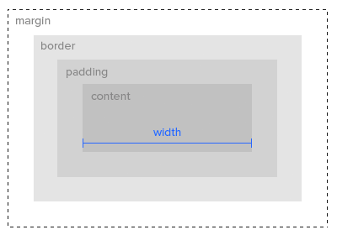
Content-box
This is the default box model.
The width and height properties includes only the content. Border and padding are not included.
You shouldn’t use this box model, it’s hard to build layouts with it.
Example

Slide 8
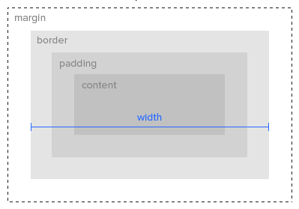
Border-box
The width, height, content, border and padding is included in the box model.
You should use this box model. It’s easy to build layouts with it.
Example 1
Example 2

Slide 9
Questions?

